Slide 1
TOEIC 250 UNIT 10

Slide 2
CONTENTS: 1. Grammar 2. Vocabulary
Grammar
Vocabulary
Future Simple
Movies
Future Perfect
Future Conti-
nuous

Slide 3
1
Grammar

Slide 4
Timeline for tenses
Past
Future
Now
Future Simple
Future Perfect
Future Continuous

Slide 5
1. FORM: (+) S + will + V (-) S + will + not + V (?) Wil + S + V? Note: will = ’ll will not = won’t
I. Future Simple
To make an offer (with “I” in (?) form using “shall”)
Eg: Shall I open the window?
To make a suggestion (with “We” in (?) form using “shall”)
Eg: Shall we go to the cinema tonight?
To ask for advice and instructions (with “I” in (?) form using “shall”)
Eg: What shall I tell the boss about this money?
To give an invitation ( with “you” in (?) form)
Eg: Will you dance with me?
2. USAGE:
To predict a future event
Eg: I think it will rain tomorrow.
To express a spontaneous decision (with “I, we”)
Eg: I’ll pay for the tickets by credit card.
To express willingness
Eg: He’ll carry your bag for you.
To give orders ( with “you”)
Eg: You will do exactly as I say.
3. SIGNAL WORDS:
Tomorrow
Next day/week/month/year
In + duration of time
Think/believe/suppose/…

Slide 6
1. FORM: (+) S + will + have p2 (-) S + won’t + have p2 (?) Will+ S + have p2?
II. Future Perfect
2. USAGE:
To describe an event that is expected or planned to happen by a particular time in the future. It gives a sense of completion of a task that will happen in the future.
Eg: I think astronauts will have landed on Mars by the year 2030.
In five years’ time, he will have finished university and will be able to earn some money.
A particular time
Now
Future
3. SIGNAL WORDS:
By ~ Not later than a particular time
- By the time + S + V - By + 1 point of time - By then
- In + duration of time (in ~ within a period of time)
- As of = By

Slide 7
1. FORM: (+) S + will + be + V-ing (-) S + won’t + be + V-ing (?) Will+ S + be + V-ing?
III. Future Continuous
2. USAGE:
To talk about something that will be in progress at or around a time in the future.
Eg: Don’t phone grandma at 7pm tomorrow, she’ll be having dinner.
The kids are very quiet. They will be doing something wrong, I know it.
A time
Now
Future

Slide 8
1. Exercise 1: Complete the sentences using will (’ll). Choose from the following:
IV. Practice
It/be she/come you/get you/like
People/live it/look we/meet you/pass
Don’t worry about your exam. I’m sure ………………………………
Why don’t you try on this jacket? …………………………… nice on you.
You must meet Daniel sometime. I think ……………………. him.
It’s raining. Don’t go out. ……………………………. wet.
Do you think …………………………………….. longer in the future?
Bye! I’m sure ………………………………… again before long.
I’ve invited Anna to the party, but I don’t think …………………………….
It takes me an hour to get to work at the moment, but when the new road is finished, …………………………….. much quicker.
you’ll pass
It will look
you’ll like
you’ll get
people will live
we’ll meet
she’ll come
it will be

Slide 9
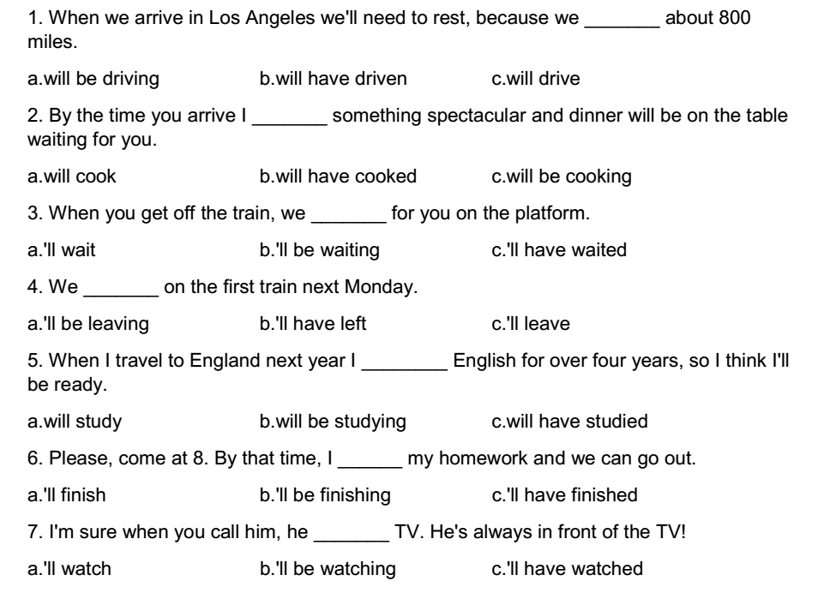
2. Exercise 2: Choose the best answer:

Slide 10
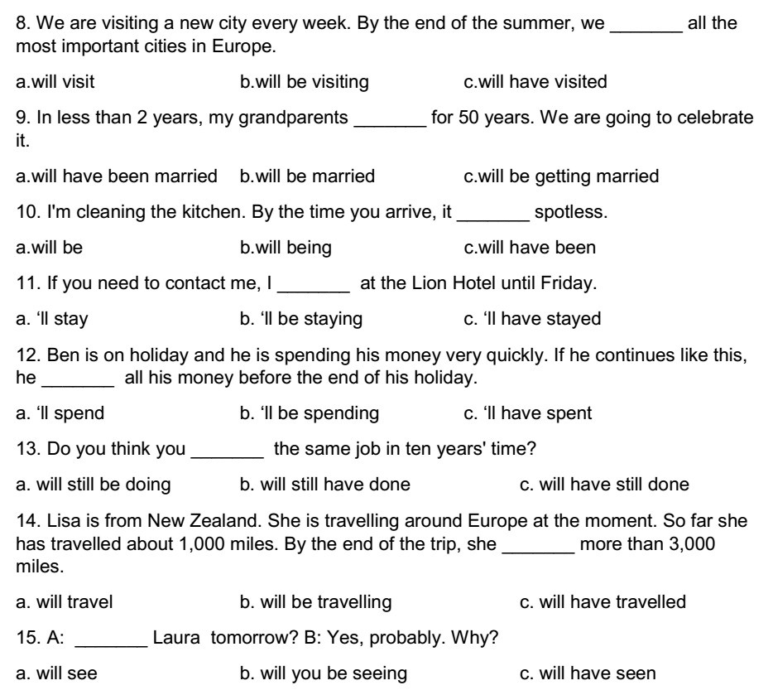
2. Exercise 2: Choose the best answer:

Slide 11
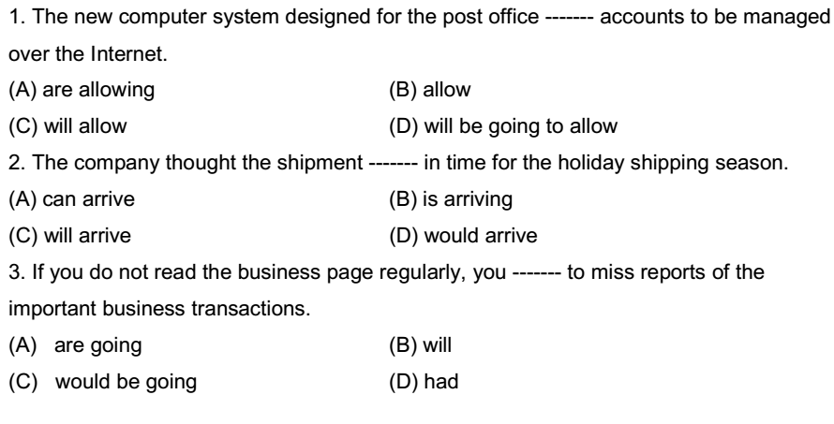
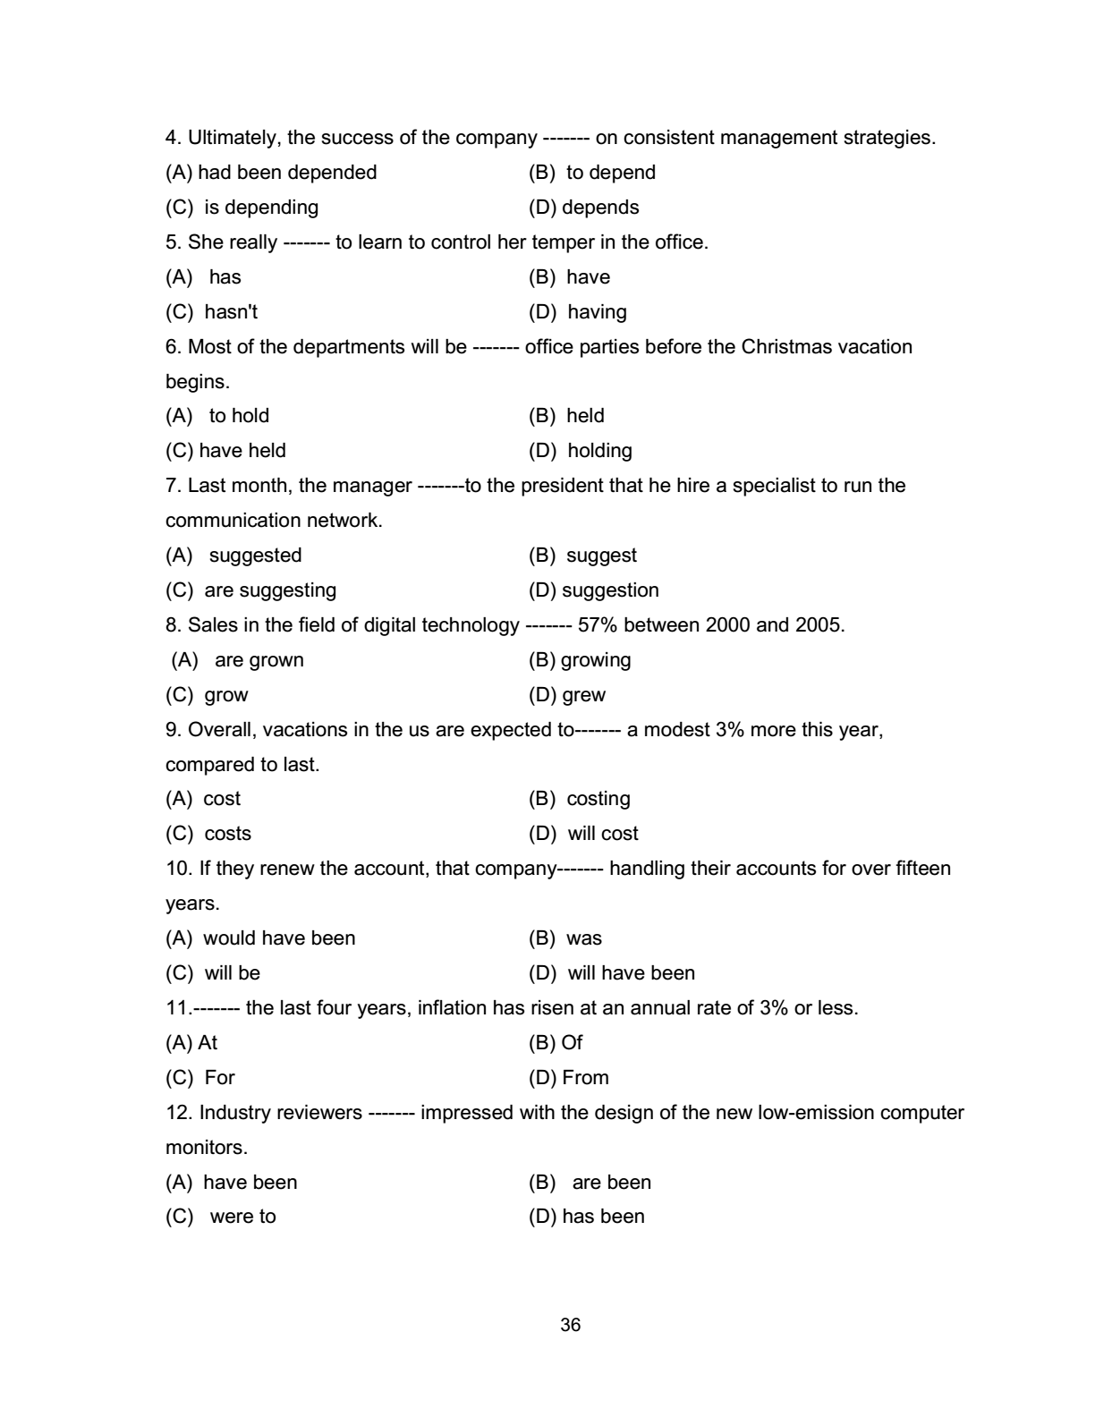
3. Exercise 3: Choose the best answer:

Slide 12
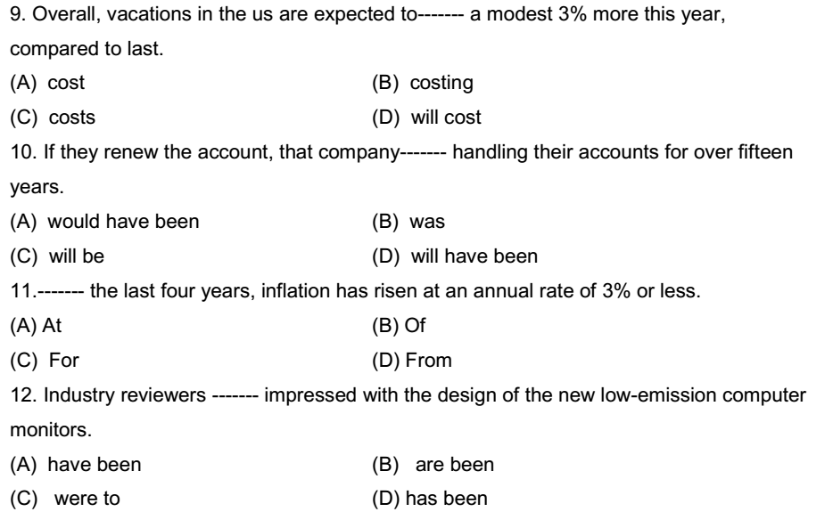
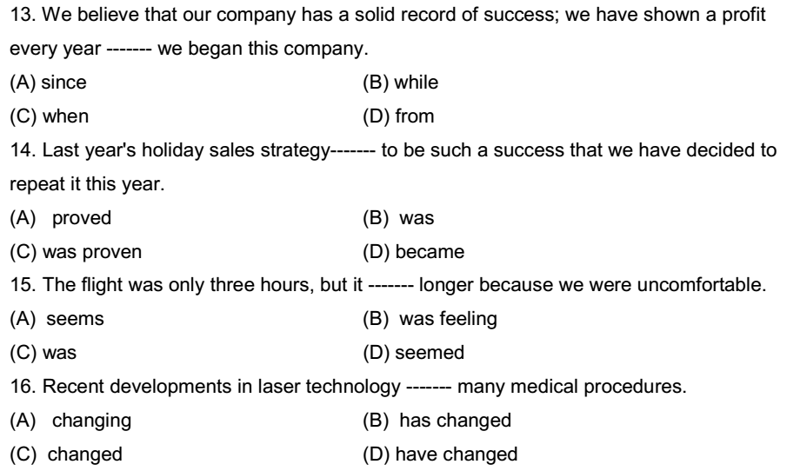
3. Exercise 3: Choose the best answer (cont):

Slide 13
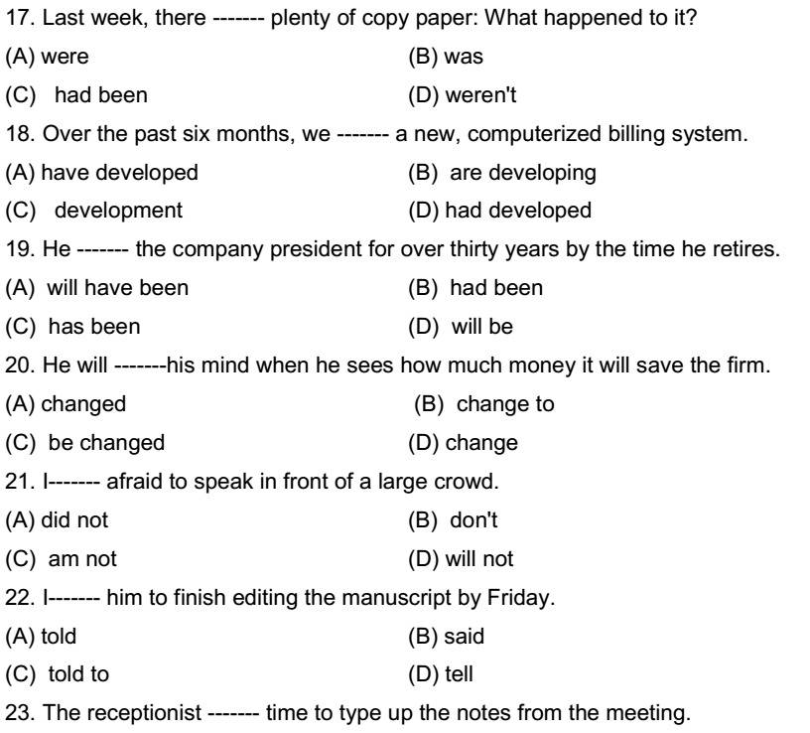

3. Exercise 3: Choose the best answer (cont):

Slide 14
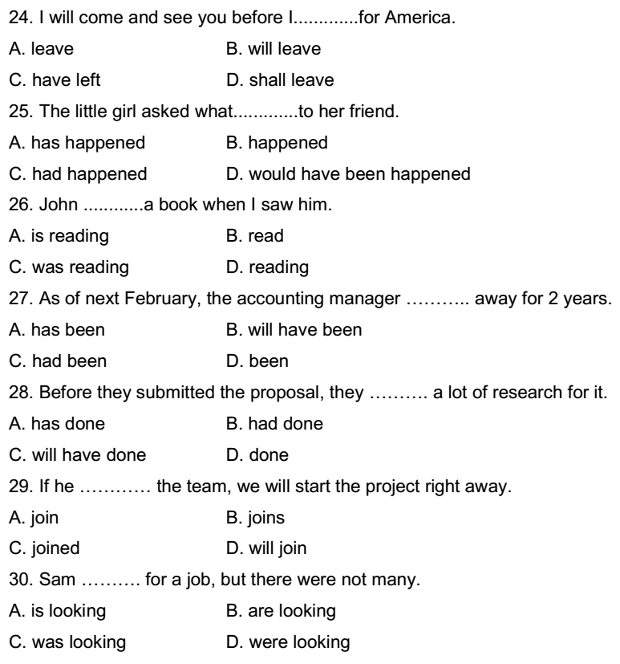
3. Exercise 3: Choose the best answer (cont):

Slide 15
VOCABULARY
MOVIES

Slide 16

attainment
n., achievement
a. The actress received a lot of attention for her many professional attainments. b. The attainment of an Academy Award validates a performer’s career.

Slide 17

combine
v., to come together
a. The director combined two previously separate visual techniques. b. The new production company combines the talents of three of Hollywood’s
best known teams.

Slide 18

continue
v., to maintain without interruption
a. The film continues the story set out in an earlier film. b. The search for a star will continue until one is found.

Slide 19

description n., a representation in words or pictures
a. The description of the film did not match what we saw on screen. b. The critic’s description of the film made it sound very appealing.

Slide 20

disperse v., to spread widely, to scatter
a. The reporters dispersed after the press agent cancelled the interview with the film director. b. The crowd outside the movie premiere would not disperse until they had seen the movie stars.

Slide 21

entertainment n., a diverting performance or activity
a. The movie was provided for our entertainment. b. There was no entertainment for children of guests at the hotel.

Slide 22

influence v., to alter or affect
a. The editor’s style influenced a generation of film editors. b. The producer was able to influence the town council to allow her to film
in the park.

Slide 23
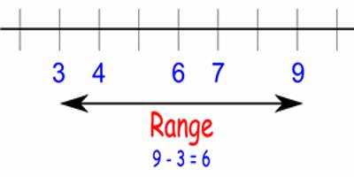
range n., the scope
a. The range of the director’s vision is impressive. b. What is the price range you are willing to pay for a ticket to the premiere?

Slide 24
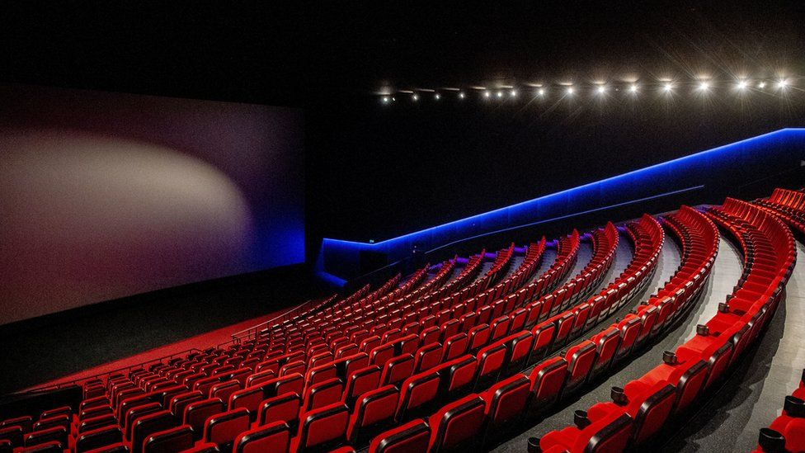
release v., to make available to the public, to give permission for performance
a. The film was finally released to movie theaters after many delays. b. The producers of the film are hoping to release it in time for the holidays.

Slide 25

representation n., exemplification; symbolization
a. The actor’s representation of his character did not seem authentic. b. The film’s representation of world poverty through the character of the hungry child was quite moving.

Slide 26

separately adv., apart
a. Each scene of the movie was filmed separately from the others. b. The theater was very crowded so we had to sit separately.

Slide 27
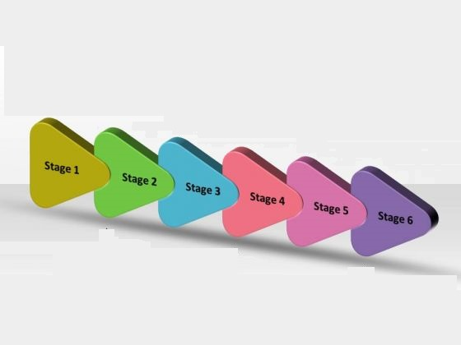
successive adj., following in order
a. The script went through successive rewrites. b. Somehow the successive images were interrupted and had to be edited again.

